Slide 1
New DPOs & data protection reform
– how to take off?
        EDPS Training, Supervision and Enforcement Unit
        29 May 2018

Slide 2

Aim of this training
DPO – how?
DPO – what?
DPO – take off!

Slide 3
Legislation: latest news
Privacy + data protection are fundamental rights
'Everyone has the right to the protection of personal data concerning them.‘ -> EU Charter Article 8 + Lisbon Treaty Article 16
Reform: 2018 NEW Regulation for EUIs
→data protection compliance becomes part of your institution’s governance
You institution’s implementing rules + Rules of procedure
(to be updated)
Member State level: *NEW* General Data Protection Regulation (GDPR)
Regulation (EC) 45/2001 on the protection of personal data by EU institutions and bodies
25 May 2018

Slide 4

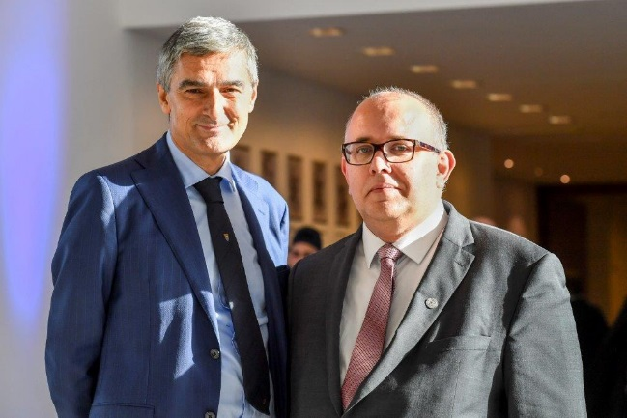
The EDPS & You
65 EU institutions + bodies
European Data Protection Supervisor (EDPS)
Giovanni Buttarelli
Your institution
Data Protection Officer (DPO)
Controller
Wojciech Wiewiórowski
Controller
Data subjects
Notes:
Add processor

Slide 5

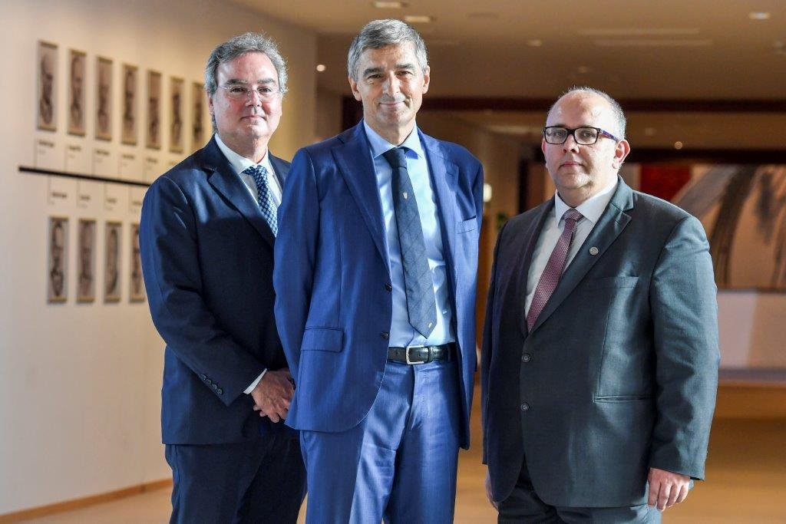
The EDPS
Supervise data processing done by EU institutions and bodies;
Advise EU legislator and appear before the EU courts;
Monitor new technologies with an impact on privacy;
Cooperate with other supervisory data protection authorities.
Provide Secretariat to European Data Protection Board (EDPB) & participate as member in its activities
Notes:
Monitoring exercises
Awareness raising
Complaints
Investigations
Prior consultations
Provide information to data subjects
Participate in the activities of the European Data Protection Board (EDPB)
Provide the EDPB with the Secretariat of the body

Slide 6
The players
Top management
Accountable
DPO
Your counsellor
Processor
Your executor
Business owner
Responsible
IT department
Your
designer

Slide 7
DPOs’ tasks... evolving
  NB: The DPOs are not the controller. They are not responsible for the lawfulness of processing operations!
  Internal advisor – to identify risks related to processing
    Proximity to controller
    Knowledge of institution
  Contributes to set up procedures
    follow up of complaints, audits, privacy by design, personal data breach notifications
  Contact point for data subjects
    to be mentioned in ‘Privacy statement’ *New*

Slide 8
EDPS and DPOs
EDPS web site: DPO corner with “starter kit”
Professional Standards for Data Protection Officers & Role of a Data Protection Officer
New – to be published soon: EDPS paper on DPOs (following DPO consultation currently under finalisation)
Practical advice, templates, presentations etc.
https://edps.europa.eu/data-protection/eu-institutions-dpo_en

Slide 9
EDPS & DPOs
Bi-annual EDPS/DPO meeting
Collaborative online platform CIRCA
EDPS DPOs’ Accountability questionnaire
EDPS hotline – each Thursday
EDPS DPO corner available at https://edps.europa.eu/data-protection/eu-institutions-dpo_en

Slide 10
DPOs key actions: awareness raising
“Inventory” of processing operations (=“cartographie”/”mapping”)
Intranet website for staff (including register of notifications/records)
28 January – Data protection day
Awareness raising campaign in your body/with other bodies: trainings involving Quiz, presentations, breakfast, debates with guest speakers, etc
Privacy by design + privacy by default *NEW*
Ensure to be involved in each new project/manual revision from the outset
in new processing operations (e.g. tick box in project vision document), IT steering committee etc.
Serves as basis for “records” & planning
DPO associated to procurement procedures leading to personal data processing
Recommendation: have this table updated at least once a year by management
for inspiration – EDPS template: Website EDPS -> DPO corner-> Inventory
Table containing all existing and planned future procedures

Slide 11
Records & Privacy statements
DPOs bread & butter tasks
Records
– Art. 31
Internal documentation
Allows risk assessment
Privacy statements
– Art. 14-16
Before collecting data = fair processing
To be drafted by Controller w DPO
Inform people
Data Protection Impact Assessment
- Art. 39
very limited cases: ”where a processing is likely to result in a high risk for rights and freedoms of natural persons”

Slide 12
Records
DPOs bread & butter tasks
Contain elements listed in Art. 31
Records kept in (ideally public) register of processing operations
  may need to be demonstrated to EDPS upon request
For standard processings & corresponding Privacy statements - get inspired by
  EDPS: https://edps.europa.eu/data-protection/eu-institutions-dpo/dpo-register_en
  COM: http://ec.europa.eu/dpo-register/search.htm
On substance: get inspired by thematic EDPS Guidelines & prior check opinions

Slide 13
How to draft your records?
Take current notifications (Art.25/27)
Use the EDPS ‘records’ template & adapt to your institution
Fill in each item with the relevant information and update information
  by Controller – in practice Director, HoU
EDPS toolkit “Accountability on the ground: Provisional guidance on documenting processing operations for EU institutions, bodies and agencies (6 Feb 2018)”
https://edps.europa.eu/data-protection/our-work/our-work-by-type/guidelines_en

Slide 14
Step by step:
Take current Notification
INFORMATION TO BE GIVEN(2)
(2) Please attach all necessary backup documents
1/ Name and adress of the controller
Executive Director EU institution XXX
2/ Organisational parts of the institution or body entrusted with the processing of personal data
Administration Department (ADMIN), more specifically HR unit
3/ Name of the processing
Health Data of Staff employed
4/ Purpose or purposes of the processing
Fulfillment of legal requirement as per the Staff Regulations upon engagement and on annual basis as well as the development of a preventive culture with respect to health.
5/ Description of the category or categories of data subjects
XXX statutory and non statutory staff
6/ Description of the data or categories of data(including, if applicable, special categories of data (article 10) and/or origin of data)
The patient’s name and first name; the doctor's name and first name; where the patient is staying; the foreseeable duration of the incapacity for work, specifying the start and end dates; Ability to work certificate (pre-recruitment). Please refer to the policy for the processing of health data for more details.
7/ Information to be given to data subjects
Staff is informed about the procedures via intranet announcement.

Slide 15
Check template – items of information (1-13) - exemple
Annex 1 – Template for records and compliance check (based on EDPS draft guidelines)
Nr. | Item | Value | Explanation
 | Reference number and version (publicly available)
1. | Last update of this record
2. | Reference number |  | For tracking – from central XXX register
 | Part 1 – Article 31 Record (publicly available)
3. | Name and contact details of controller
4. | Name and contact details of DPO | dataprotection@xxx.europa.eu
5. | Name and contact details of joint controller (where applicable) |  | If XXX is jointly responsible with another EU institution (EUI), please indicate so here. If this is the case, make sure to mention in the description who is in charge of what and to whom people can address their queries.
6. | Name and contact details of processor (where applicable) |  | If you use a processor (contractor) to process personal data on XXX’s behalf, please indicate so (e.g. 360° evaluations, outsourced IT services, use of data processing tools or pre-employment medical checks).
7. | Purpose of the processing |  | Very concise description of what you intend to achieve; if you do this on a specific legal basis, mention it as well (e.g. staff regulations for selection procedures).
8. | Description of categories of persons whose data are being processed (data subjects) and list of data categories. |  | In case data categories differ between different categories of persons, please explain as well (e.g.: suspects vs. witnesses in administrative inquiries).

Slide 16

III.a Comply with DP principles
 | Part 2 - compliance check and risk screening (internal)
 | Compliance check (Articles 4 and 5)
14. | Legal basis and necessity for processing (see Article 5 of the proposal): (a) necessary for performance of tasks in the public interest attributed by EU or MS legislation (a2) (a) as per recital 17, second sentence (b) necessary for compliance with legal obligation incumbent on controller (c) necessary for performance of a contract to which the DS is party (d) consent (e) vital interest |  | Choose (at least) one and explain why the processing is necessary for it. Examples: (a) a task attributed to XXX by legislation, e.g. procedures under the staff regulations or tasks assigned by the Agency’s founding regulation. Please mention the specific legal basis (e.g. “Staff Regulations Article X, as implemented by XXX IR Article Y”, instead of just “Staff Regulations”) (a2) not all processing operations required for the functioning of XXX are explicitly mandated by legislation; recital 17 explains that they should nonetheless be seen to be covered here, e.g. internal staff directory, access control. (b) a specific legal obligation to process personal data, e.g. obligation to publish declarations of interest in XXX’s founding regulation. (c) this is rarely used by the EUIs. (d) if persons have given free and informed consent, e.g. a photo booth on EU open day, optional publication of photos in internal directory; (e) e.g. processing of health information by first responders after an accident when the person cannot consent – not so relevant to XXX.
15. | Purpose definition: Do you list all purposes in point 7 above? Are the purposes specified, explicit, and legitimate? Where information is also processed for other purposes, are you sure that these are not incompatible with the initial purpose(s)? |  | Explain in more detail the purpose and its legitimacy and competence of XXX to achieve it. Be as more detailed and explicit as possible; cover all possible cases.
16. | Data minimisation: Do you really need all data items you plan to collect? Are there any you could do without? |  | Explain clearly why the different categories of data are needed; cover all possible cases of the data processing.

Slide 17
III.d Comply with DP principles
 | Part 2 - compliance check and risk screening (internal)
 | Compliance check (Articles 4 and 5)
17. | Accuracy: How do you ensure that the information you process about people is accurate? How do you rectify inaccurate information? |  | E.g. information may be collected directly from the persons; there might be available means for the persons to directly check and rectify it.
18. | Storage limitation: Explain why you chose the storage period(s) mentioned in point 9 above. Are they limited according to the maxim “as long as necessary, as short as possible”? In case you only need some information for longer, can you split storage periods? |  | Note that data may be kept after the legitimate retention period in anonymised form (i.e. individuals are no longer identified or identifiable). Consult the DPO for further info if needed.
19. | Transparency: How do you inform people about the processing? |  | E.g. privacy statements on forms, e-mail notifications: provide more detail on different types of information. If you do not want to inform people (or only inform them after the processing has been performed), consult the DPO.
20. | Access and other rights of persons whose data you process: How can people access, rectify or delete their data? Who should they contact and how? Are there cases where access, rectification or deletion is not permitted and why? |  | Explain clearly the procedures for access, rectification and deletion of personal data. Clearly mention contact points (e.g. an email address or specific person) that will handle such requests. If there could be situations where you would want to refuse e.g. granting access, consult the DPO.
21. | Where are your information security measures documented? |  | Provide a link to relevant information security documentation if available. Otherwise, provide more detailed description of applicable measures.

Slide 18
Record: Selection of experts
(Extracted from data protection register)
Title | Call for expression of interest :Experts
EDPS case Number | N/A
Notification Status | Notified
Controller Name | John Doe john.doe@ec.Europa.eu, Head of Unit ICT
1.a. Part of the Institution | Administration and Support
1.b. Processors | Procurement
1.c. Contact Person
2. Name of the Proccessing | CEI list of experts
3. Purpose of the Processing | Establishing a list of Experts for identifying emerging and future risks posed by new ICTs (See attached document)
Date of Submission | 16/06/2011
4. Description of the category of data subjects | External experts hired by XXX for specific tasks
5. Description of the data or categories of the data | 1. Name and address of the applicant 2. CV of the applicant 3. Personal Tax File (Fiscal) Number 4. Application form – Call for expression of interest. 5. Solemn declaration that candidates are not in a situation of conflict of interests
6. Information to be given to data subjects | Information provided through the application form (data subjects are required to give their consent). Privacy Notice to be updated.
Right to have access | By email to the 'Procurement' mailbox.
Right to rectify | By email to the 'Procurement' mailbox.
Right to block | By email to the 'Procurement' mailbox.
Right to erase | By email to the 'Procurement' mailbox.
Right to object | By email to the 'Procurement' mailbox.

Slide 19
Record: Selection of experts
Title | Call for expression of interest : Experts
8. Automated/ manual processing operation | Manual Processing operation
9. Storage space and storage media | Files are kept on Intranet (initially on a restricted basis - successful applicants are then are open for perusal by staff only).
10. Legal basis | The Financial Regulation and the Implementing rules; data subject's consent.
11. Recipients | Procurement Team, Appointed members of the evaluation panel. Staff members when needs for expertise have been duly identified to carry out projects.
12. Retention policy for categories of data | Data are kept as long as the CEI is open (4 years) to applications and for a period of one year after closure of the procedure.
13.a. Time limits
13.b. Historical, statistical purpose | N//A
14. Proposed transfers of data | N/A
How and when | N/A
15. Specific risks | N/A
16. Comments | -
17. Measures to ensure security of processing | All files related to CEI processing are exclusively stored on the intranet.
 | Contract.pdf
Attachments

Slide 20
Practical questions
Given that your EU institution organises several expert selection rounds every year, how would you proceed in terms of records ?
Is a new record necessary every time you organise an event?
How to ensure consistency across your EUI?
No! Harmonise your procedure and indicate differences (where necessary) in one record.
e.g.: COM “Model notifications” for experts, event organisation etc.

Slide 21
When to carry out a DPIA?
Processing is on the list of kinds of risky processing operations to be issued by the EDPS
Processing is likely to result in high risks according to your threshold assessment
EDPS Toolkit “Accountability on the ground: Provisional guidance on documenting processing operations for EU institutions, bodies and agencies”, section 4 and Annex 5 & 6 for threshold assessment

Slide 22
DPIA or not?
DPIAs or not?
Large scale profiling data bases: Europol
Processing of genetic or biometric data
Large scale processing of vulnerable data subjects (i.e children)
staff selection procedures and recruitment
payroll processing
registration of journalists and other visitors
NB: Even if no DPIA, still risk assessment

Slide 23
How to demonstrate compliance?
Before collecting data inform persons = fair processing
Review and update privacy statements
information « in an intelligible and easily accessible form, using clear and plain language »:
  identity of the controller, purpose, recipients, rights, legal basis...
  *NEW* contact details of the DPO, info on transfers to recipients outside the EU.
How? Data protection notice on intranet, internet, on paper forms ...

Slide 24
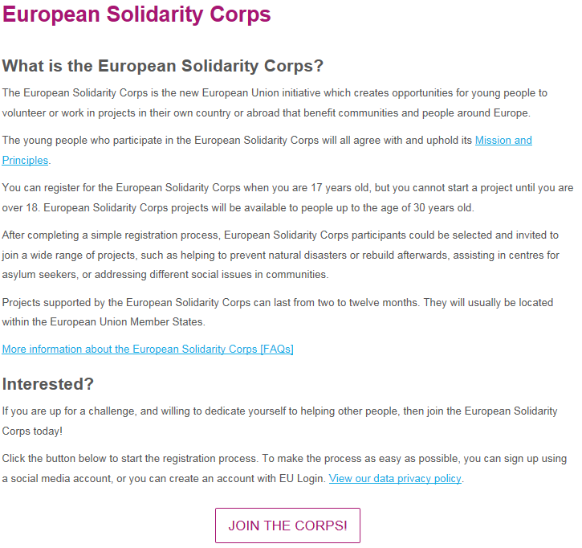
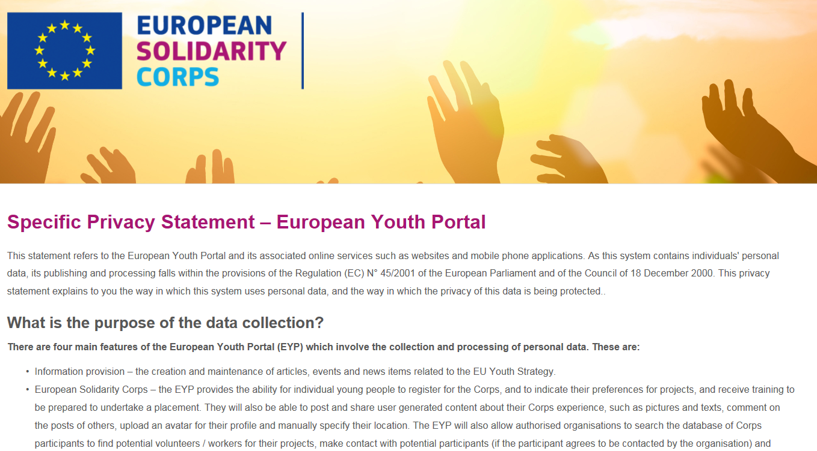

Slide 25
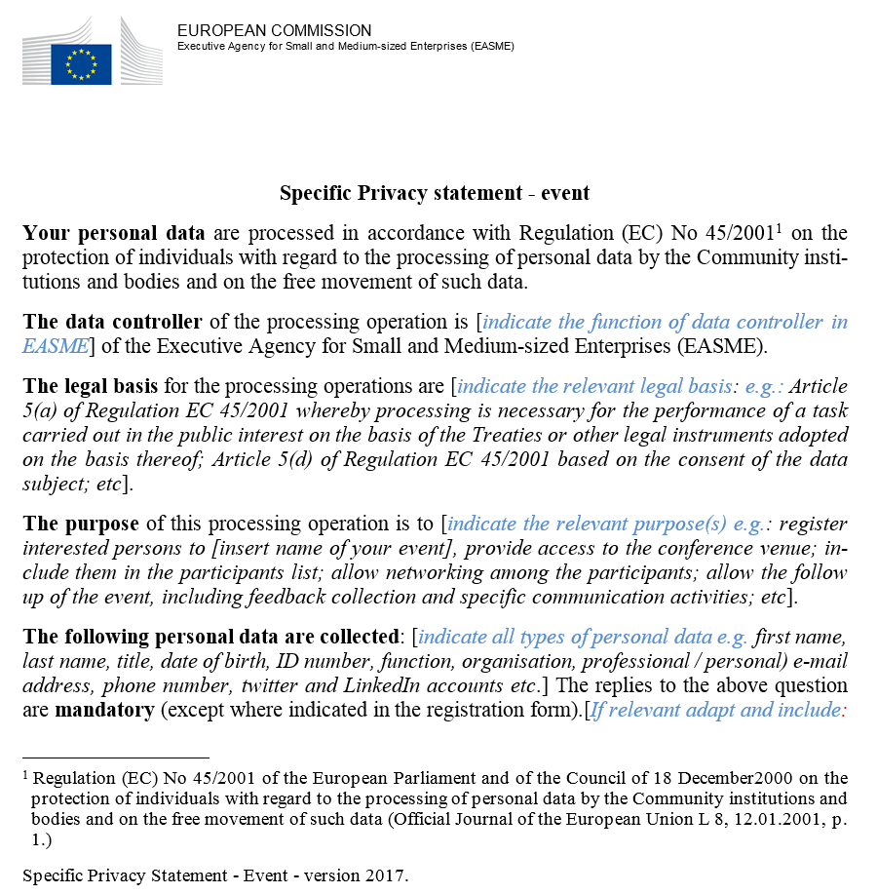
Event management, model PS

Slide 26

In a nutshell
Unit designs new processing operation
Collection, storage, transfer
Privacy by design & by default!
EDPS thematic Guidelines for inspiration
1
*New* for Controller:
records + risk assessment
2
Privacy statements
Drafted by Controllers
3
DPO advises on conformity
with Regulation
3
Launch
procedure
Register by DPO
*New*: Records
to be kept by Controller
4
Verification by EDPS
DPIAs only in limited cases

Slide 27
Get involved in outsourcing (Article 29)
eg: SLA, procurement, external experts...
Controllers and processors both accountable!
Privacy as award criterion: « Procure secure »
Review, update and renegotiate contract clauses
Contractual safeguards (security, confidentiality)
Privacy statements, no sub-sub-contracting...
Controller can verify compliance via audits
Remember privacy by design & by default
Clarify roles controller/processor
Processor should act only on behalf of the controller

Slide 28
Breach notifications
EUI to notify the EDPS not later than 72h
*NEW*
not only hacking, theft etc... but also disclosure of correspondance, laptop or usb stick loss etc...
DPO to contribute to draft new procedure, e.g. update existing IT security incident procedure - > include LISO, IT, management
See circa for inspiration, there are examples
Include reporting obligation on newcomers’ training, undertake awareness raising exercises etc.

Slide 29


Factsheet
“What to expect when we inspect”
https://edps.europa.eu/data-protection/our-work/publications/factsheets/factsheet-5-what-expect-when-we-inspect_en & EDPS Rules of procedure, Articles 15(3) and 36
Notes:
https://edps.europa.eu/sites/edp/files/publication/factsheet_5_en.pdf

Slide 30
What now?
Take aways

Slide 31
DPO’s plan – let’s take off!!
New processing operation - ensure to be involved
New procurement including personal data?
Initiate drafting of personal data breach procedure
People ask access to their personal data or rectification?
Contribute to draft tender data protection specifications & use specific clauses & PS
People have rights. Inform & ensure follow—up with Controllers.
Get inspired by EDPS thematic Guidelines
Update inventory + templates: Records & PS
Update implementing rules
Existing processing
controllers to update content & re-check lawfulness
Project vision document, steering committees, Inventory...
Implement Privacy by design & by default: check compliance with DP rules from the outset of all projects/manuals
Establish transition action plan & request management support
see circa for inspiration

Slide 32



Q? A!
  For more information:
    www.edps.europa.eu
    edps@edps.europa.eu
    Subscribe to our monthly newsletter (click)

