Slide 1
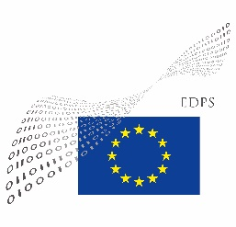
Data Protection Impact Assessments
ECB PUBLIC
EDPS-DPO meeting
04 June 2021

Slide 2
Agenda
Introduction (10 min)
Discussion in 4 groups on different topics (25 min)
Break (10 min)
Presentation by each group (each 5 min)
Presentation by the EDPS (15 min)
Group discussion & questions (10 min)
A summary of our discussion will be presented to the plenary in the afternoon.
All slides will be made available afterwards.
Please speak up to ask a question or make a comment (we can’t monitor the chat all the time).

Slide 3
Main sources
Regulation (EU) 2018/1725 (‘EUDPR’)
Recitals 57-58
SECTION 4 “Data protection impact assessment and prior consultation”
Article 39: DPIA
Article 40: Prior consultation
Article 2(3): Exception: not yet applicable to operational personal data by Europol and the European Public Prosecutor’s Office
Article 89/90: Eurojust
Guidelines of Article 29 Data Protection Working Party of 04 April 2017
EDPS Accountability on the ground Part II of 03 July 2019
Who does what / How to carry out a DPIA / When to do prior consultation / How to get ready
Decision of EDPS of 16 July 2019
Threshold assessment

Slide 4
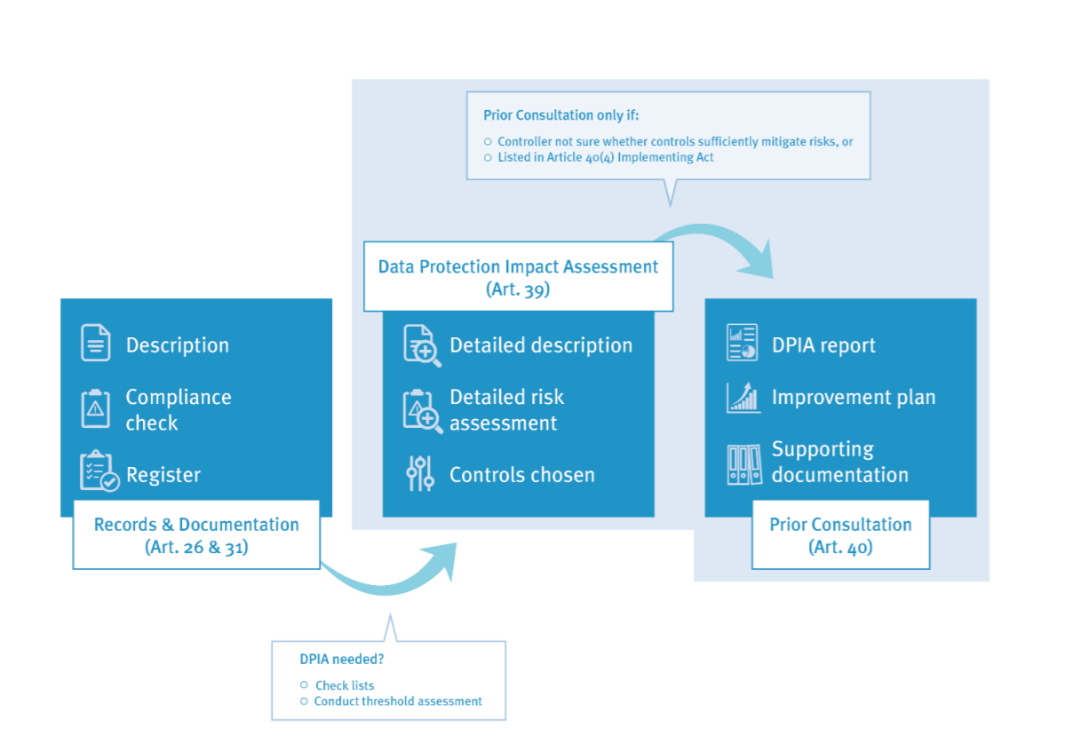
Three step approach

Slide 5
-Ingredients of a DPIA
A splash of a systematic description of the envisaged processing operations and the purposes of the processing;
A hand full of an assessment of the necessity and proportionality of the processing operations;
A spoon full of an assessment of the risks to the rights and freedoms of data subjects;
A sliver of the measures envisaged to address the risks…taking into account the rights and legitimate interests of data subjects and other persons concerned;
..and a bit of additional ingredients of your liking.
“Baking may be regarded as a science, but it's the chemistry between the ingredients and the chef that gives desserts life.” (A. Olson)

Slide 6
Statements
The following slides contain provocative statements. These are meant to trigger a discussion but do not reflect the opinion of any particular individual or organization.

Slide 7
1
The EDPS needs to issue a mandatory DPIA template for EUI’s
Usefulness of a single template for all EUI’s

Slide 8
Feedback from the group
A template would be very useful, but only ‘recommended’
Practical guidance on how to use template, with examples
DPO network should be involved based on experience
Template should not be too complex, understandable for all staff
Detailed template with optional parts would be useful
Threshold assessment needs an updated

Slide 9
2
Every aspect of a DPIA needs to be very detailed
Level of detail of DPIA’s

Slide 10
Feedback from the group
Level of detail is conditional on the template used
Introductory part is similar to the records, referral could be enough
More concise in descriptive parts, referring to existing documents
Level of detail should be sufficient to enable mitigation of risks
Clear description in an understandable language for decision makers
The analysis shall be detailed, the summary concise

Slide 11
3
DPO’s should draft DPIA’s
At what stage and how should a DPO be involved in the drafting of DPIA’s

Slide 12
Feedback from the group
First draft needs to come from controller, knows underlying processes best
DPO need to be there for several drafting stages
DPO is there to explain data protection principles
Continuous involvement of/ cooperation with the DPO
DPO does not have resources to chase for information, someone needs to be appointed from controller’s side

Slide 13
4
The full DPIA needs to be completed at the very start of the project
When should a DPIA be completed?

Slide 14
Feedback from the group
DPO needs to be consulted when IT solutions/ architecture are designed (privacy by design), so before procurement
In practice DPO is often involved too late
Not realistic to have it completed at the very beginning
In some EUI’s, solutions were found to involve DPO earlier, e.g. including data protection as a step in general process descriptions

Slide 15
5
Completed DPIA’s should be centrally published
Transparency will allow exchanges between DPO’s / avoid duplication

Slide 16
“Completed DPIA’s should be centrally published”
There is value in publishing DPIA’s, but not centrally by EDPS
Often, records will say whether or not a DPIA was prepared, a summary of a DPIA can be included or link to the full DPIA
Publication may increase pressure to not do a DPIA
Relevance to other EUI’s is not always given (e.g. for inhouse systems)
It is for DPO network to avoid duplication

