Slide 1


Accelerating Digital ID Adoption
June 2022

Slide 2
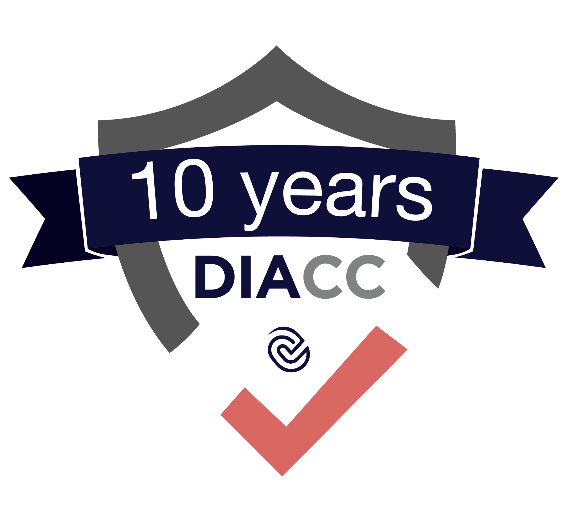
DIACC is
trust framework provider
entity responsible for development and compliance verification for an information assurance framework

Slide 3
Pan-Canadian Trust Framework (PCTF): Verify Assurance
Standards
People and processes implementation of technology standards
Technology
Technology and model agnostic for application across scenarios
Policy & Governance
Operational assurance verification aligned with regulations
People
Builds confidence needed to accelerate adoption
SAML, OpenID Connect, FAPI, SIOP, W3C, ZKP, Hyperledger Aries or Indy, FIDO, NIST 800-63, etc.
Applicable models including federations, platforms, operator networks, self-sovereign identity, APIs, hybrid
Verify policy and regulatory assurance and conformance of individual capabilities, integrated services, and networks
Provides signal for adopters – people, decision makers, investors

Slide 4
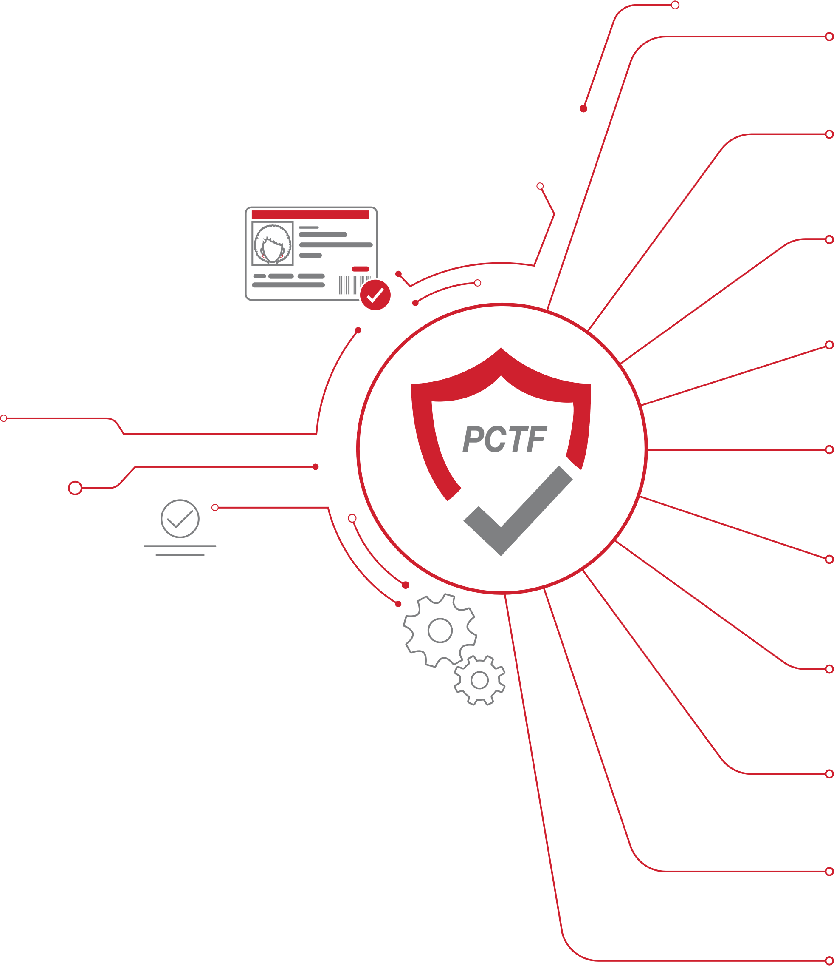


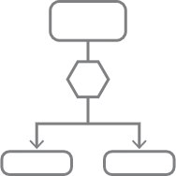









Pan-Canadian Trust Framework (PCTF) v1.0
Assurance Maturity Model
Information assurance framework for verifying identity capabilities
Glossary
Model
Authentication
Credentials (Relationships & Attributes)
Digital Wallet
Infrastructure (Technology & Operations)
Privacy
Notice & Consent
Verified Organization
Verified Person
Informative
Specified
Encompassing

Slide 5








Thank you!
Contact us to learn more about the PCTF and Voilà Verified Program.
Work with DIACC to reduce uncertainty for adoption of privacy-protecting digital ID
diacc.ca
@mydiacc
/company/mydiacc
/mydiacc

