Slide 1
FOOD FOR THOUGHT FROM A FINANCIAL INDUSTRY PERSPECTIVE
on e-IDAS 2.0
IPEN – WARSAW 2022
Jacoba Sieders
ING Group / Rabobank International / Abnamro / European Investment Bank / Dutch Blockchain Coalition / Idemia / Dutch Railways / Health-care / EUDI developer Armana / Advisory board member ESSIF-Lab, ID-Next, SonicBee, Capitar Security

Slide 3
1 – SOME PRACTICAL CHALLENGES
Waiting for 25 Implementing Acts to appear after proposal is accepted
Discussions on toolbox and standards not finalised
EU tender already launched for implementations, coalitions and developments creating tomorrow’s legacy?
Introducing increased number of items and roles in a more labour intensive model Who will implement, certify, monitor, audit these in a world with massive lack of security and privacy specialists?
Wallets, User Agents, DL infrastructure, EAA, Archiving, Attribute Registries, semantic taxonomies, onboarding of legal entities in various roles, need for decentralised auditing, etc.
Fragmented trust value chains coming through coalitions of partners each delivering parts & elements
Concern: Shared liability, cost / income distribution, competitor / IP positions, legal entity decisions are complex puzzles to solve When cost-, risk-, and security issues appear in real life cases, they kill ‘friendly co-operation of the willing’

Slide 5
2 – THE USER ADOPTION CHALLENGE
What will make the difference for e-IDAS 2?
Since 2011 we had STORK, STORK2, in 2020 e-SSIF-lab, 2018 e-IDAS 1
Are privacy- and user-centricity enhancements enough to create coverage and uptake?
Issuers of EAA, VC get no real incentives but may face significant cost for implementation and user support
Fear of liability issues, internal operations- and legacy challenges
Banks, heavily regulated / audited: massive, slow, conservative IT change procedures
Hindering adaptation to roles as EAA issuer, Relying Party. But they are most likely your key players
Is Section III, Article 12a, 2 -3: the solution?
“Where private Relying Parties are required […] to use SCA […] including in the areas of transport, energy, banking and financial services, social security, health, drinking water, postal services, digital infrastructure, education or telecom services, they shall also accept the use of the EUDI Wallets, […
…] where very large online platforms […] require users to authenticate to access online services they shall also accept the use of EUDI wallets […] strictly upon voluntary request of the user [... “
SCA: Digital identity / IAM as preventative control - complemented with detective controls
(transaction monitoring, pattern recognition, device fingerprinting, SOC-information) Significant redesign in backoffices may be needed in a distributed scheme (PSD2 client fraud example) Doesn’t help Relying Parties’ appetite to rely on external trust sources

Slide 6
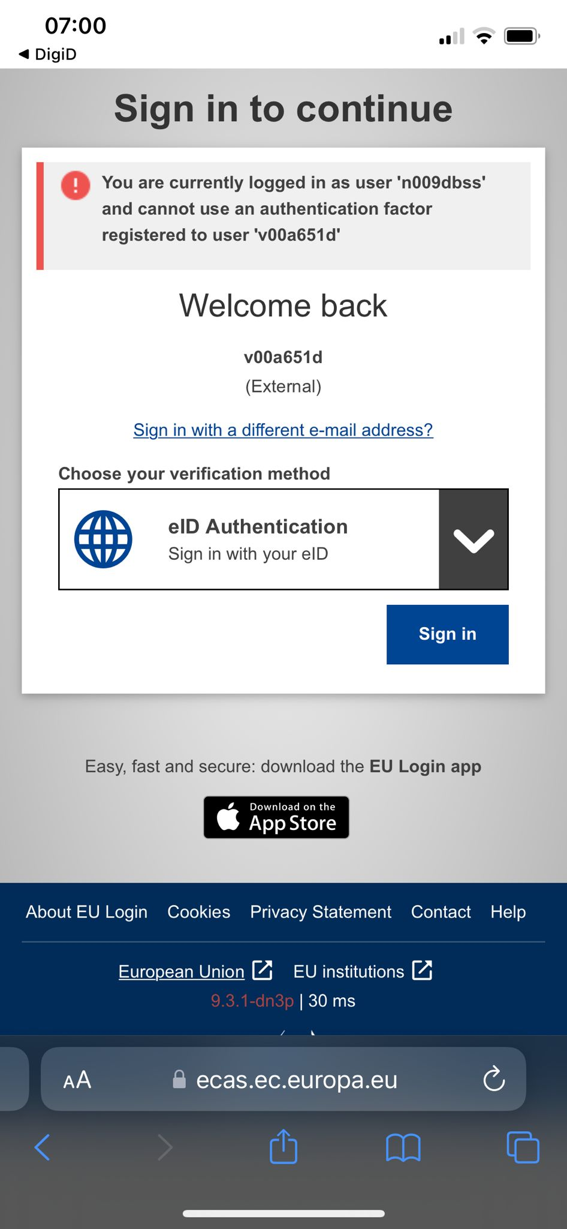
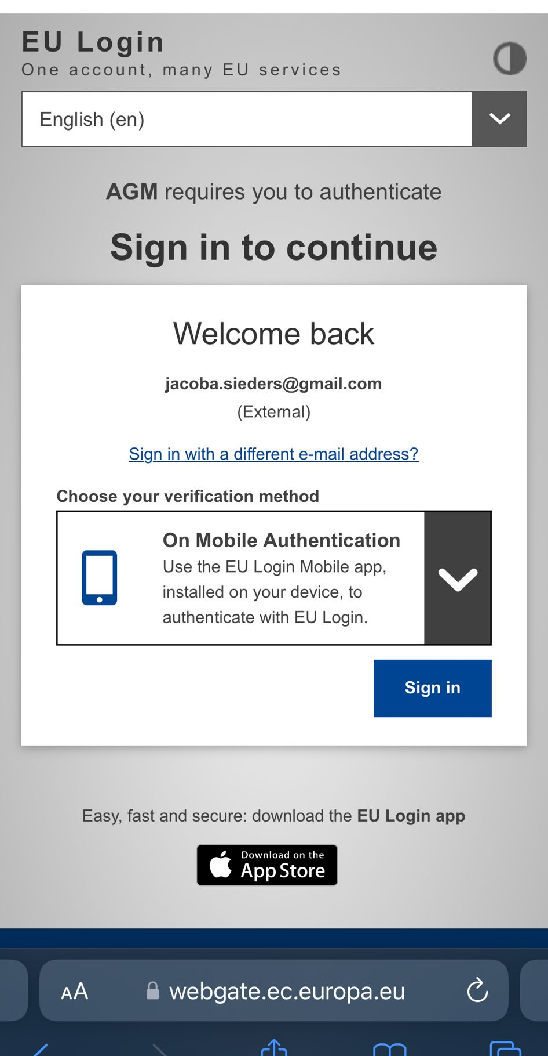
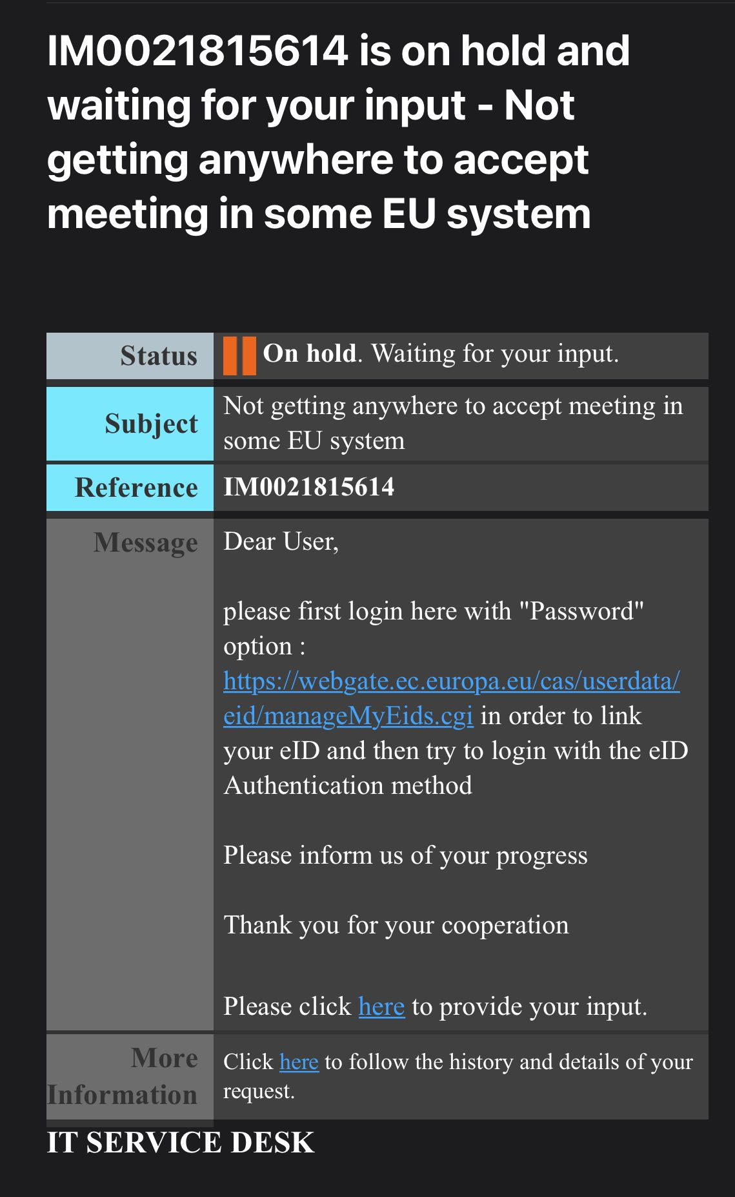
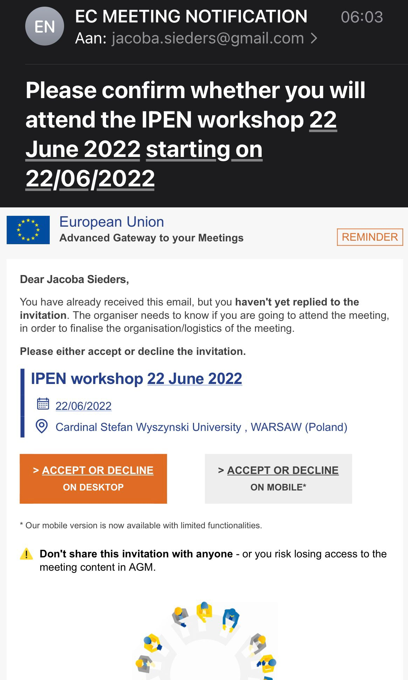
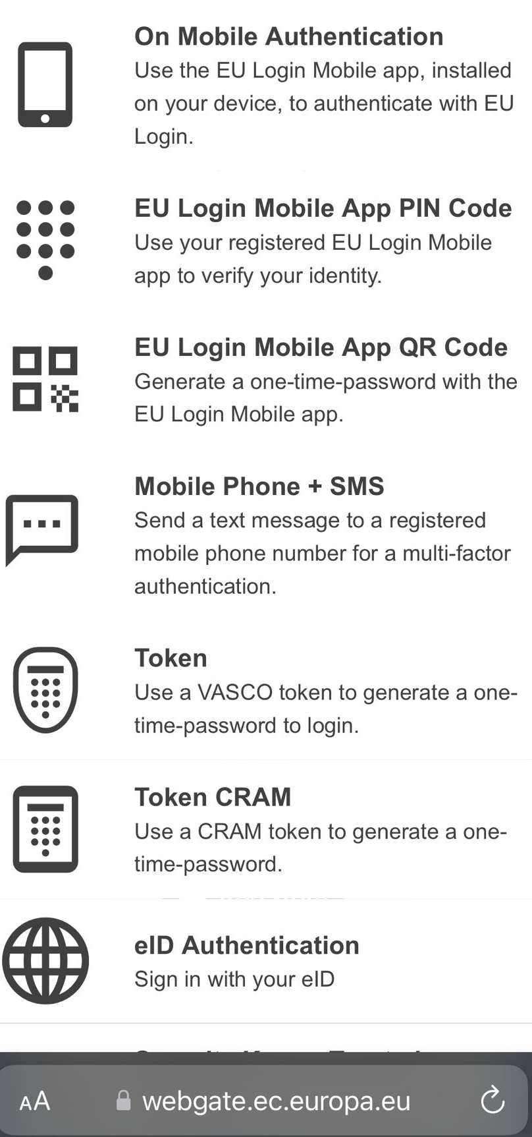
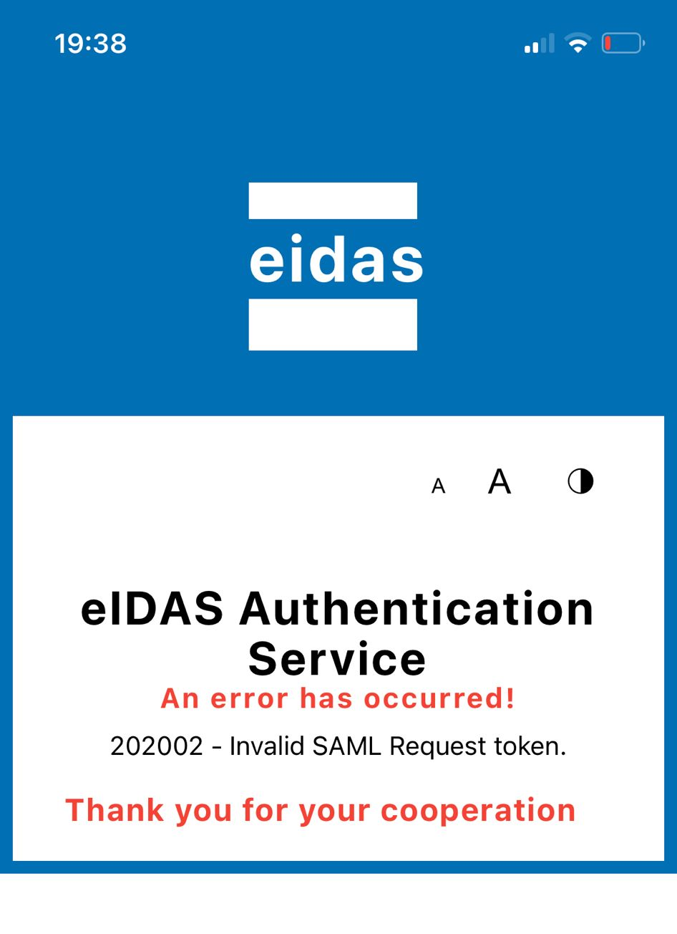
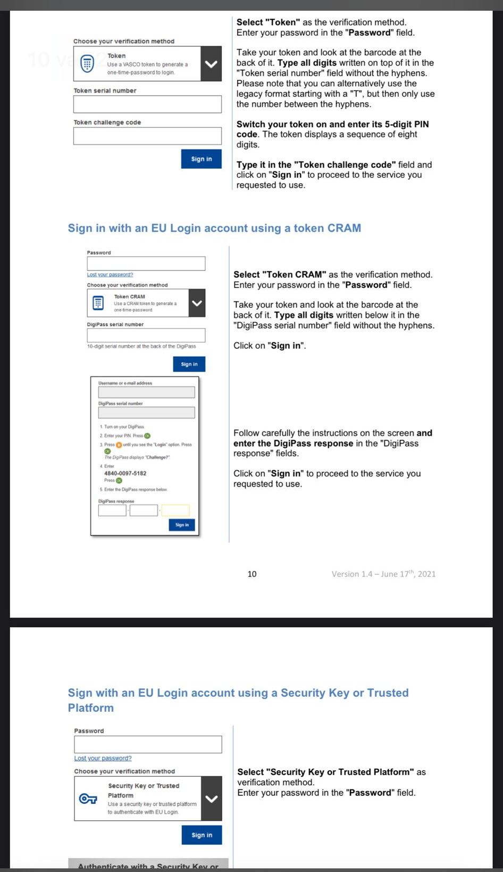
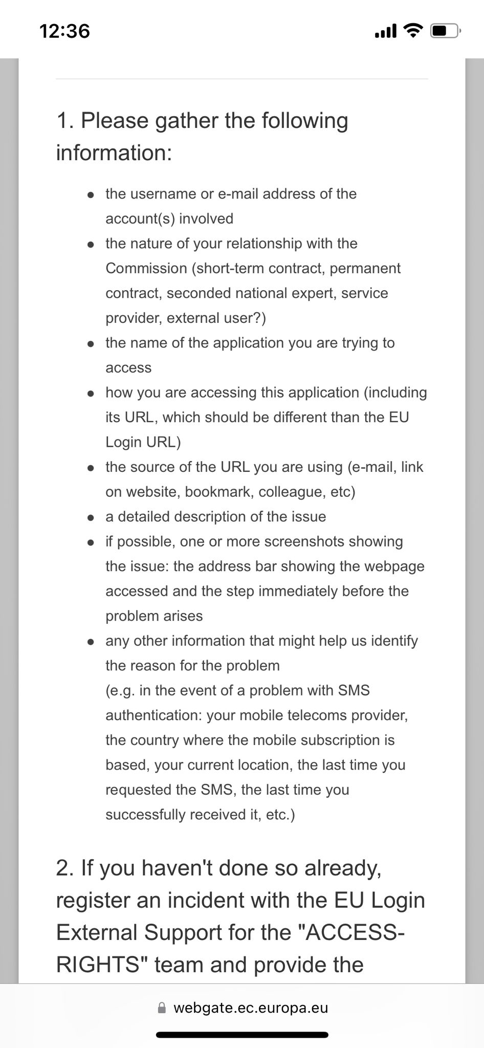
Secure customer journey – including customer choice...

Slide 8
3 - COMPLEXITY INCREASED COMPARED TO PREVIOUS E-IDAS
Fragmentation may increase, not decrease by e-IDAS 2.0
Super complex ecosystem of ecosystems
ID-wallet ecosystems interacting with traditional federative ID ecosystems, Idaas, OPA,... Oversight for both users and providers may be lost
Classical IAM challenges will increase or become more exposed
E.g. delegated authorisation structures, role definitions / changes, data formats, internal correlation of duplicate entries, re-enrolment and approval flows, third-party data definition, data quality and -ownership topics,... Decentralised ID models will increase complexity of these challenges for organisations internally
And interoperability challenges with existing technology and legacy are probably not yet fully apparent
Transparent incident support flow with all parties more difficult to establish (user, RP, Wallet Issuer, EAA Issuers, etc.)
Finger pointing to each other for incident resolution at the cost of users

Slide 9
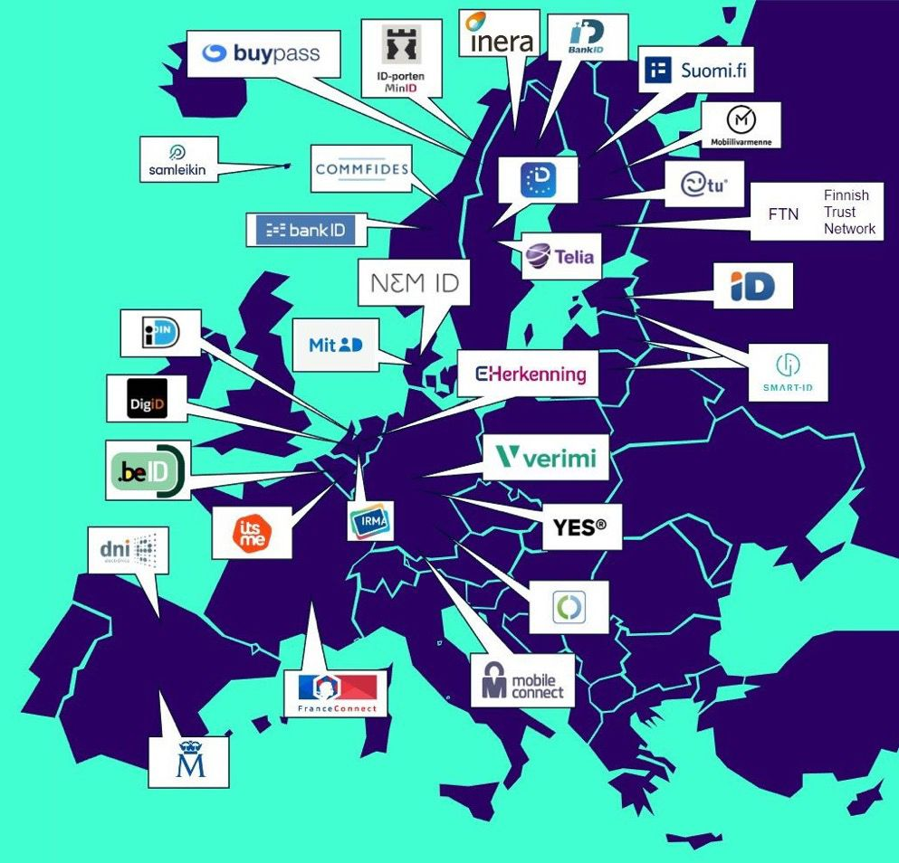
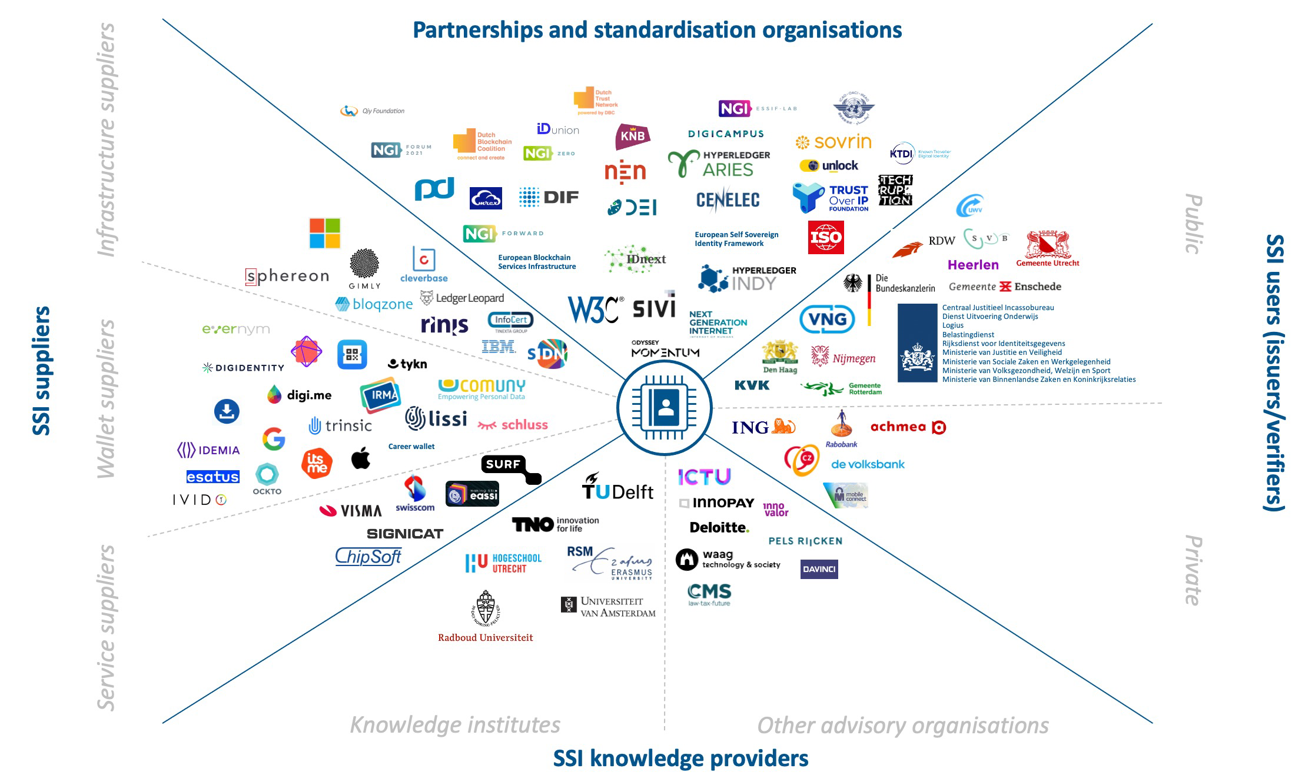
https://eudiwalletconsortium.org/https://eudiwalletconsortium.org/
eudiwalletconsortium.org
2022-04-25 Update - Member states Sweden, Finland, Luxembourg and France are in the final stages of consortium membership. Norway, Germany and Greece in detailed discussion. Several other member states started discussions. Non-government participants: Sicpa, DSGV (German Savings Bank Association), Archipels, ID Union, University of the Aegean, Digidentity, Signicat, NETS, Intesi, InfoCert, Avast, Validated ID, Spherity, Amadeus, SIDN, Skyteam.
National ID ecosystems EU
Source: Signicat, 2022
Germany: IDunion 2021

Slide 10
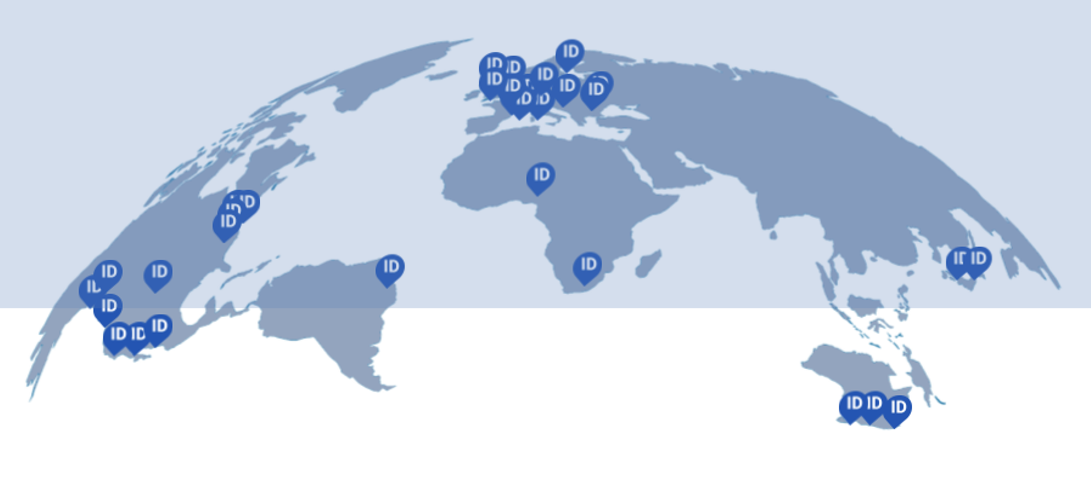
GLOBAL ASSURED IDENTITY NETWORK (GAIN)
Financial industry “Solving the ID quest for the globe”
150 seasoned dedicated ID experts best capabilities driven by idealism
Driven by parties with decennia of practical experience, large footprints
Some participants: FFI, GLEIF, Cloud Signature Consortium, Open ID, The Open Identity Exchange
Large national ecosystems connecting: Aadhar, Canada, Australia,..
Vendors becoming actively involved: PING, Microsoft, Avast/Evernym…
Involvement EU?
Source: GAIN whitepaper, 2021
https://gainforum.org/

Slide 11
Indicative: a snapshot state of play NL
Source: Innopay, 2021

Slide 12
10 DISCUSSION TOPICS
Great privacy and user-centricity intentions – But we are already bound to adhere to GDPR Do we need to prescribe the ID model to be used?
Will privacy- and user-centricity enhancements really boast adoption by users?
Since 2011 we had STORK, STORK2, in 2020 e-SSIF-lab, 2018 e-IDAS 1. What difference will e-IDAS 2 make?
Should an EUDI Wallet button for SCA-bound online services really be mandatory (Article 12)?
Time-, cost- and resource pressure are significant. Players in the field are not even beginning to be aware of the proposal let alone the impact. Will organisations be prepared to take their role in the game and bear the negative impact?
Is a decentralised ID model really necessary to balance privacy, security, and usability?
Open source or not?
Distributed Ledger infrastructure or not?
Fear of user nightmares based on complexity of support flow, number of parties involved
Private large tech providers can move fast, smaller but ‘better’ parties may lose due to size and massiveness of the current tender requirements and consortium dynamics. How to balance this?

